Slide 1
Lecture 2
2.1 Why Cities as Complex Systems?
Concepts of Organized Complexity and Human Ecology
©Luís M. A. Bettencourt 2024
IUS 1.3 Cities as Complex Systems

Slide 2
- When can we understand (and intervene) in cities “one issue at the time”?
This is typically how city agencies and traditional urban planning and policy makers act:
- If the problems of cities are systemic, can cities be designed from scratch to be better?
Urban Utopias: EcoUtopias (Garden Cities), Industrial Utopias (Modernist City), Architectural Utopias (so many),
Political Utopias (Brasilia,…), TechnoUtopias (Smart Cities), …
- From the beginning, many urbanists argued that cities are natural social forms,
with their own predictable, emergent properties not understandable from narrower approaches
For example: Aristotle, Patrick Geddes, Camillo Sitte, Robert Park and Ernest Burgess (Chicago School Sociology), Lewis Mumford,
Jane Jacobs, Christopher Alexander, and many more recent authors
We will follow Jane Jacobs strategy, which is the most analytic, factual and scientific of these.
Notes:
When is a complex systems perspective necessary? Usually on larger scales, for longer times, around problems of development, poverty, racism and exclusion, and any other times problems are “systemic”. This is always the case in cities, but sometimes when things are going well we can pretend that issues are separate.

Slide 3
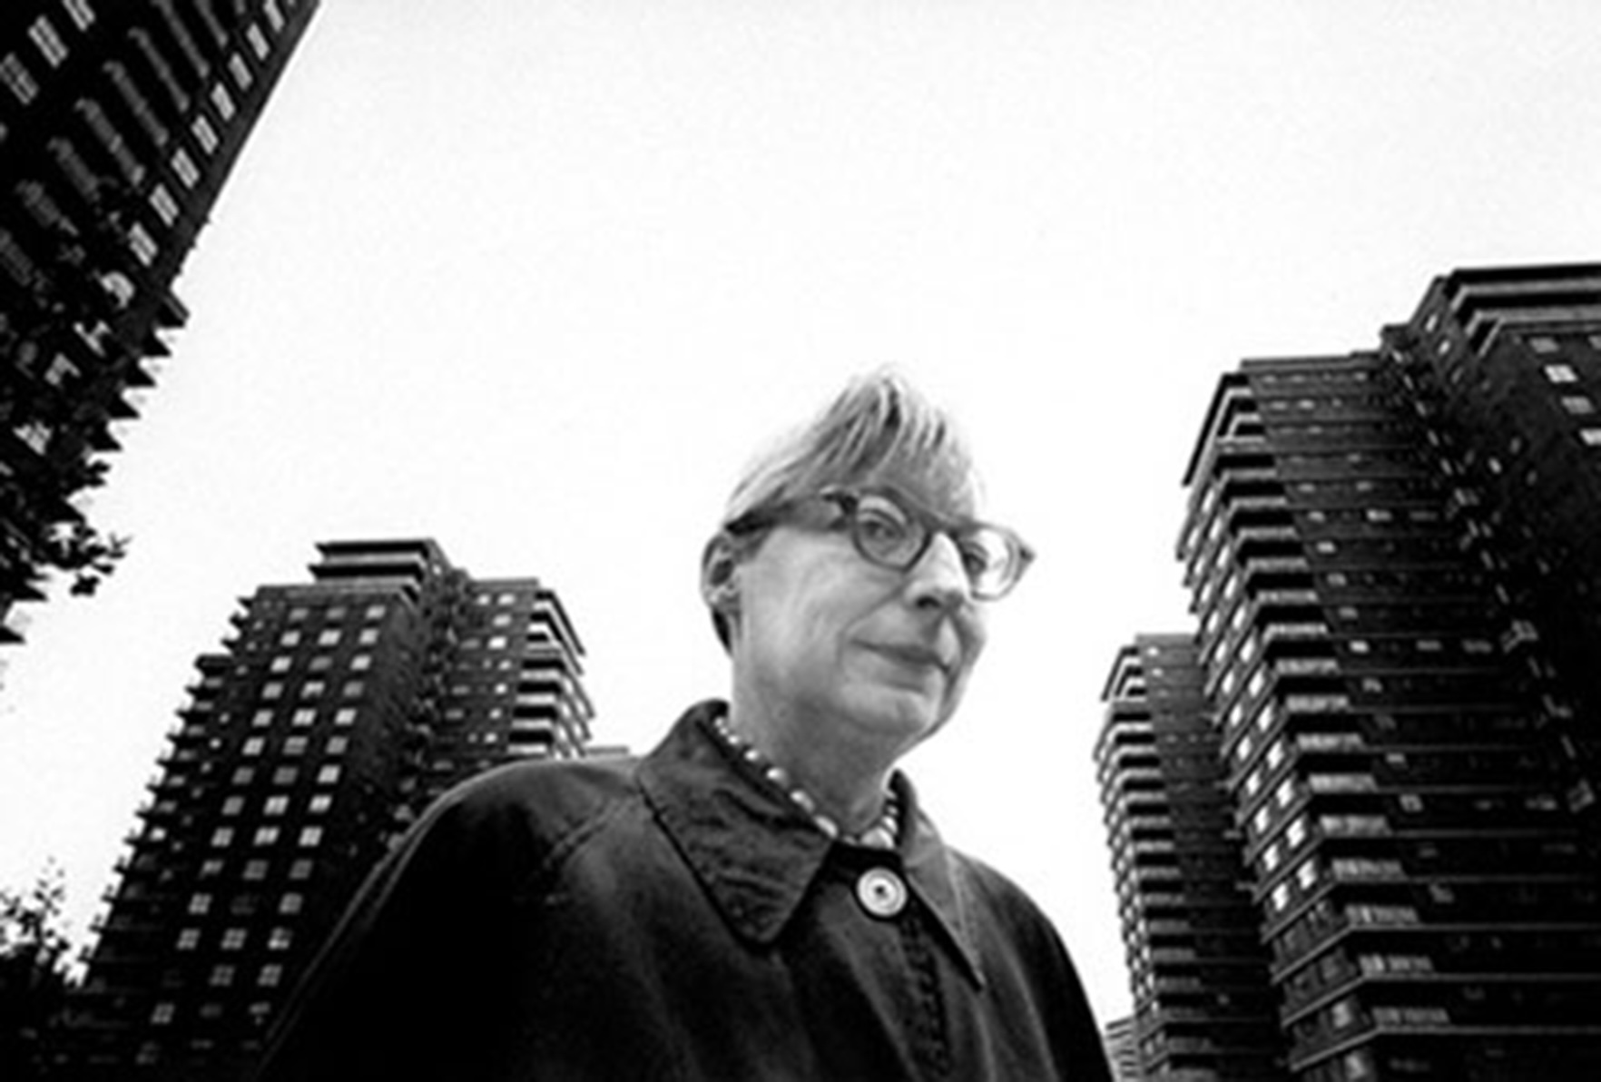
[ Real cities present ] situations in which several dozen quantities
are all varying simultaneously
and in subtly connected ways
Jane Jacobs
The death and life of great American cities, 1961
Your reading materials
Notes:
I follow Jane Jacobs in the last chapter of her death and life book. She realized that to fight the kind of pure infrastructure intervention that Robert Moses was pushing (a highway through lower Manhattan) she not only needed to organize people, se also needed a better theory of what cities are.

Slide 4

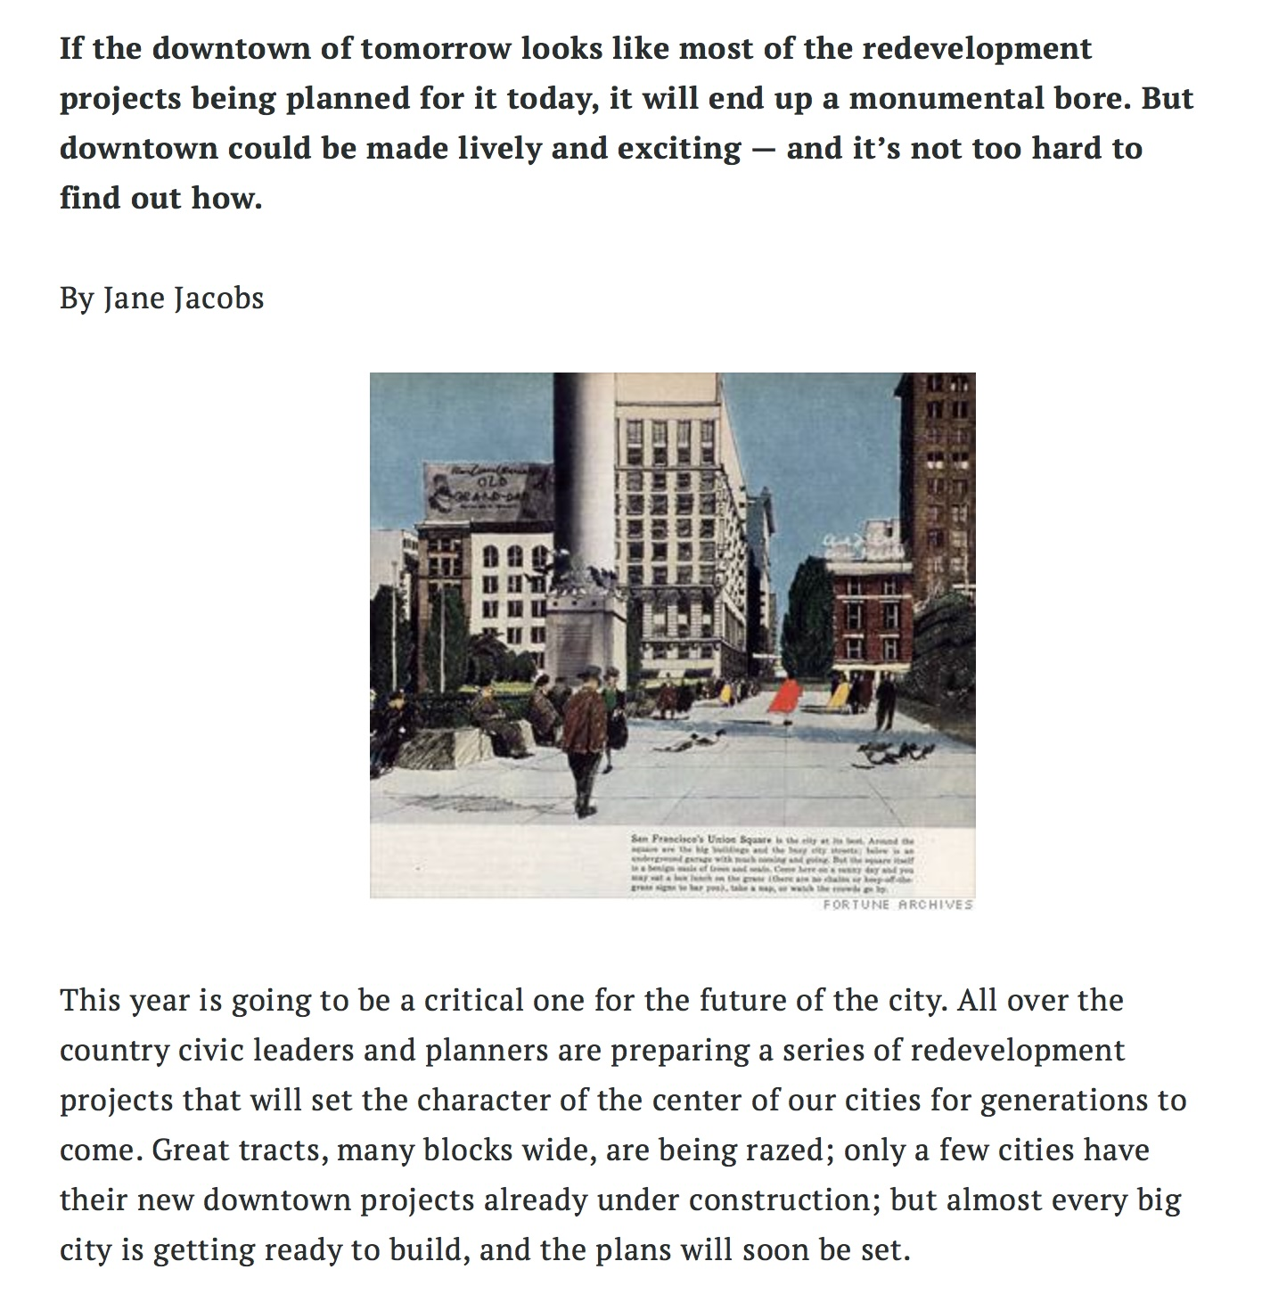
Jane Jacobs early breakthrough essay
think of cities for people, not just industrial infrastructure
https://fortune.com/2011/09/18/downtown-is-for-people-fortune-classic-1958/

Slide 5
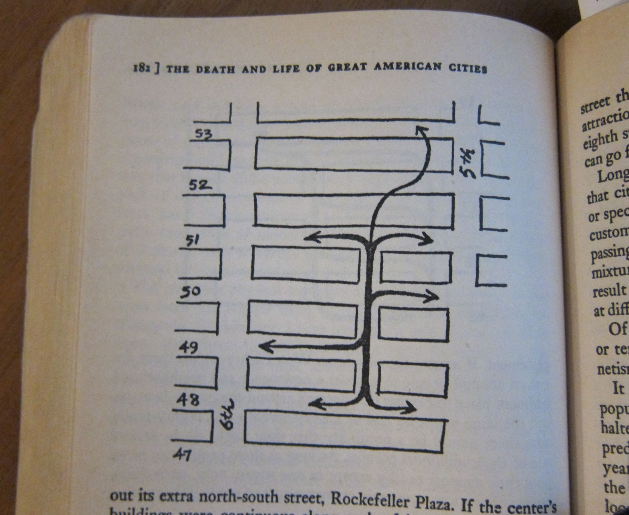
Jane Jacobs, The death and life of great American cities, 1961
Jane Jacobs observed how people use urban built spaces and what makes them successful or failures

Slide 6
Industrial Utopia
population density in the wrong places
public spaces given to cars
uniformity and drabness in the name of efficiency
Le Corbusier: Ville Radieuse 1924-33

Slide 7
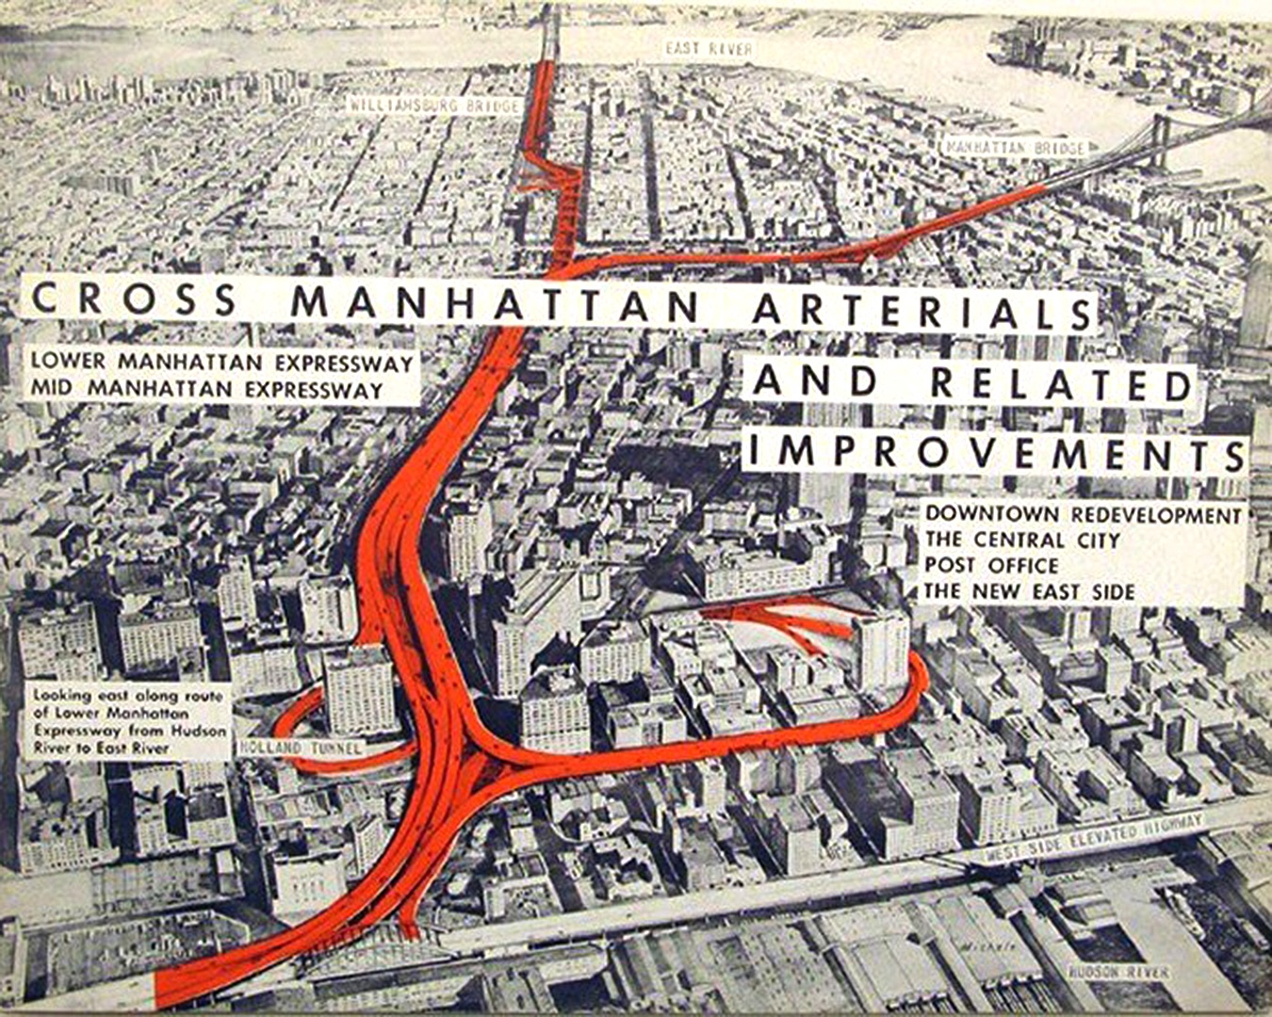
To fight modernist planning based mainly on the expansion of industrial infrastructure (highways and traffic flows)
Jane Jacobs proposed not just activism; she proposed a new theory of cities (Ch 9)

Slide 8
Jacobs’ Criticism of Urban Planning and Policy
The death and life of great American cities, 1961
Reading: Chapter 22 “The Kind of Problem a City is”
Too Simple
Too Statistical (“bird’s eye view”, averages)
Too Sentimental (especially in dealing with Nature)
The wrong way of thinking to help create good cities
Cities are natural
The cities of human beings are as natural, being a product of one form of nature, as are the colonies of prairie dogs or the beds of oysters.
Cities are not “heaps of problems”, they are the solutions
“Big cities have difficulties in abundance because they have people in abundance.”
Vital cities have marvelous innate abilities for understanding, contriving and inventing what is required to combat their difficulties.
The surplus wealth, the productivity, the close-grained juxtaposition of talents that permit society to support advances […] are themselves products of our organization into cities, and especially into big dense cities.
Notes:
I make my students swear an “oath” that they will not see cities merely as “heaps of problems”.

Slide 9
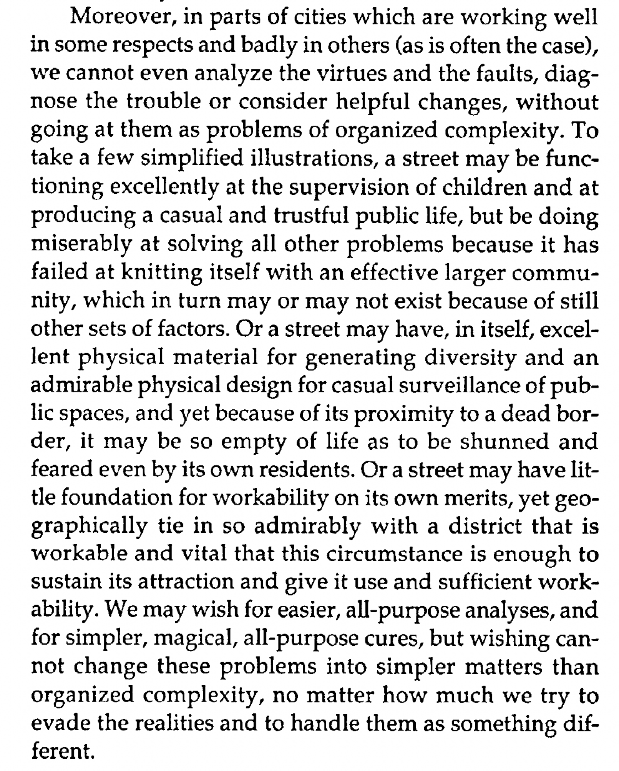
pp. 566
Scenario 1: “Private street”
Scenario 2: local versus wider design
Scenario 3: centrality

Slide 10
Causal Diagram for What Makes a “Good” Park
Jacobs, Ch 22, pp. 565
age of buildings
size of blocks
housing
“Any single factor about the park is slippery as an eel, it can potentially mean any number of things”
population
Your first assignment
park
design
choice
competing
uses
neighborhood park
means a positive influence
The existence of loops in the diagram
entails circular causality
virtuous and vicious cycles + possible equilibrium
means a negative influence
Notes:
I ask students to draw causal diagrams of urban processes, as a way to clarify their hypotheses and reveal potential mechanisms. Here is my attempt to draw a diagram about her description of why a park works or not.

Slide 11
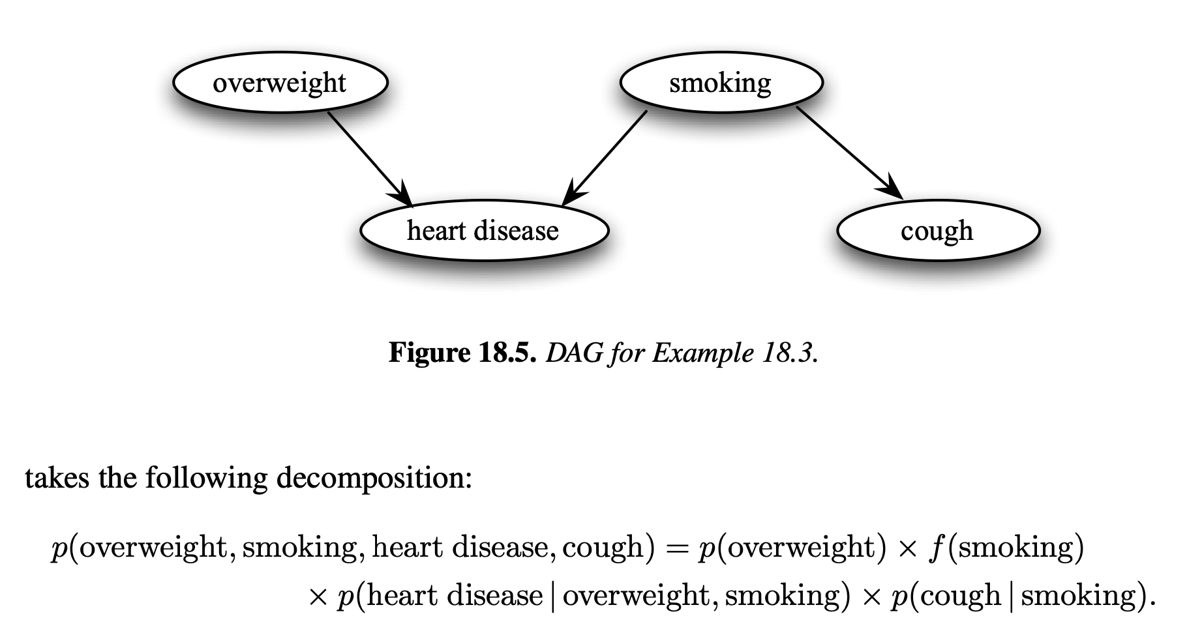
Causal diagrams are probabilistic graphical models
Representations of (conditional) probabilities
directed acyclic graph
https://www.stat.cmu.edu/~larry/=sml/DAGs.pdf

Slide 12
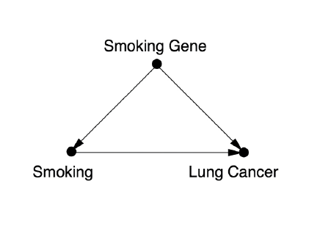
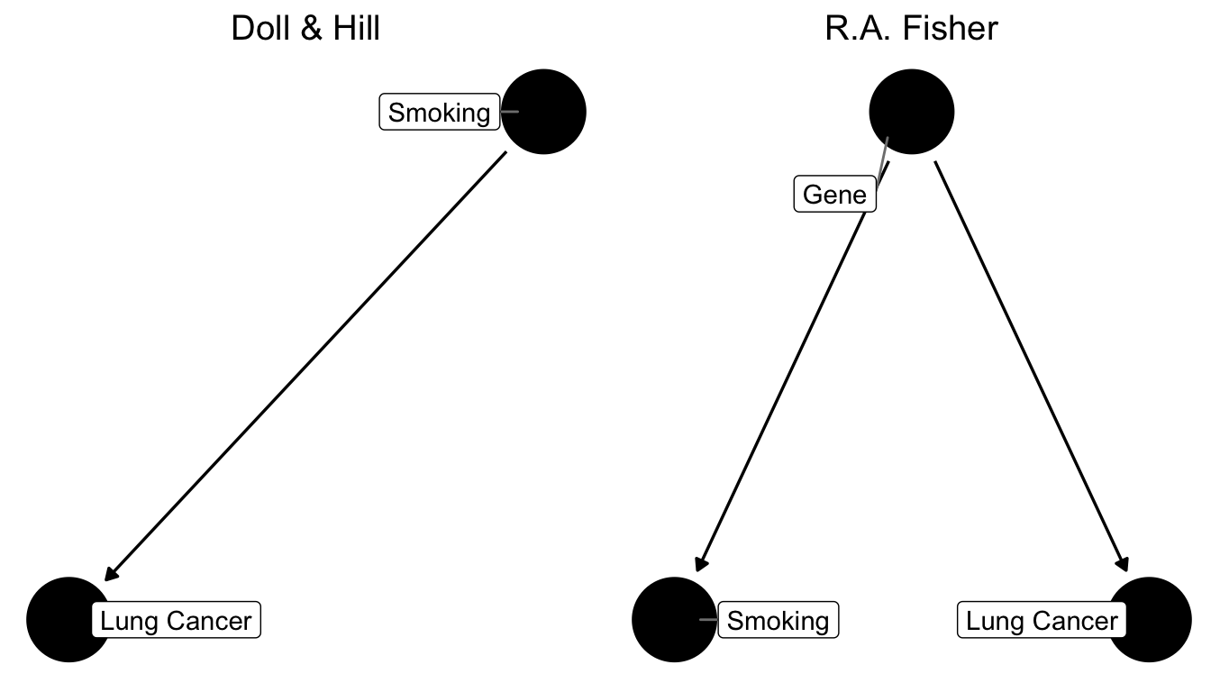
Tool for thinking: The Causal Diagram
If you think you have a theory (explanation) for a phenomenon, you should express it as a Causal Diagram
Confounder
“collider “
$$p(lc)=p(lc|s,g)p(s|g)p(g)$$
The causal diagram is not a final answer; it is a hypothesis !
Notes:
There’s a world of causal diagrams… but they are a very useful, clarifying tool, rarely used in urban planning or the social sciences.

Slide 13
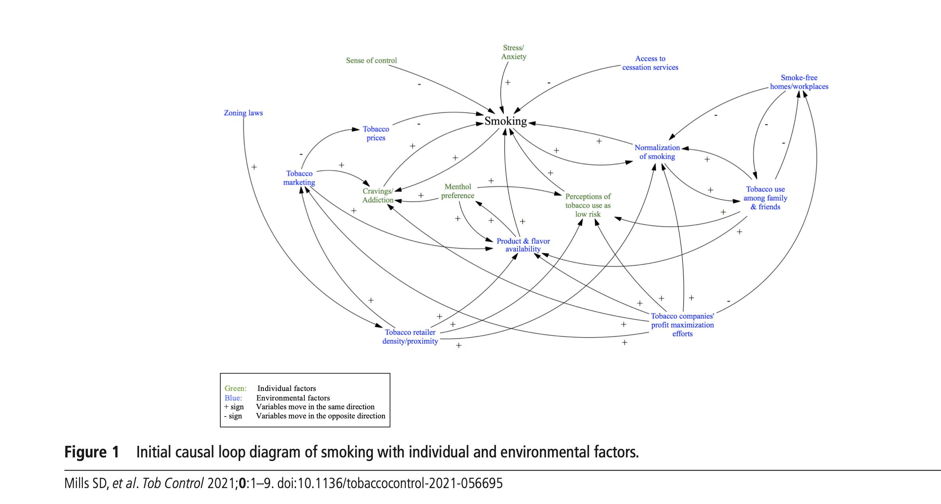
It can get quite complicated, with external factors and virtuous and vicious cycles
https://tobaccocontrol.bmj.com/content/tobaccocontrol/early/2021/09/16/tobaccocontrol-2021-056695.full.pdf
Notes:
It is the cycles (virtuous and vicious) that make these processes complex.

Slide 14
Causal Diagram for What Makes a “Good” Park
Jacobs, Ch 22, pp. 565
“Any single factor about the park is slippery as an eel, it can potentially mean any number of things”
age of buildings
size of blocks
population
Your first assignment
park
design
choice
competing
uses
neighborhood park
means a positive influence
The existence of loops in the diagram
entails circular causality
means a negative influence
Virtuous and vicious cycles calls for "policymaking in the loop”
Notes:
If you can set a virtuous cycle in motion, that is your goal. How to stop vicious cycles?

Slide 15
How should we build a theory of cities?
“The kind of problem a city is”
J. Jacobs 1961: The death and life of great American cities, ch. 22
Ways of scientific thinking
Merely to think about cities and get somewhere, one of the main things to know is what kind of problem cities pose.
Which. avenues of thinking are apt to be useful and to help yield the truth depends not on -how we might prefer to think about a subject, but rather on the inherent nature of the subject itself.
Weaver’s Classification of Problems in Science
1. Simplicity
2. Disorganized complexity
3. Organized complexity
W. Weaver 1948 , Science and Complexity
https://www.jstor.org/stable/27826254
cities
Jacobs
Notes:
Here is what Jacobs proposes for how to build a theory of cities… “Organized Complexity”

Slide 16
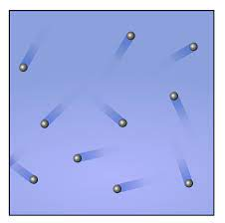
1. Simplicity
2 variables
clear case and effect
determinism
Examples: solar system, demand curve, representative agent u-maximization
solar system
2. Disorganized Complexity
large number of identical components
no history (do we care about history of a gas?)
ask only average questions (temperature, pressure,…)
gases and liquids, telephone exchanges, insurance
$$∼{10}^{26}$$
gas in a box
credit: wikimedia commons
Notes:
She contrasts this with other phenomena and their theories. This comparison disqualifies purely mechanical (classical physics, or certain forms of economic theory), as well as purely statistical (such as via a lot of averaging, including some forms of machine learning).

Slide 17
3. Organized Complexity
today we call them:
complex adaptive systems
or simply “Complex Systems”
They are all problems which involve dealing simul­taneously with a sizable number of factors, which are interrelated into an organic whole
Although the interrelations of their many factors are complex, there is nothing accidental or irrational about the ways in which these factors affect each other.
We cannot even analyze the virtues and the faults, diagnose the trouble or consider helpful changes, without going at them as problems of “organized complexity”.
Diverse, interdependent agents
Connectivity structure
Information and Learning
Costs vs benefits
History
Notes:
This is what we today call complex systems

Slide 18
Jane Jacobs Proposed Strategy for Studying Cities:
“A growing number of people have begun, gradually, to think of cities as problems of organized complexity - organisms that are replete with unexamined, but obviously intricately interconnected, and surely understandable, relationships.”
To understand Cities we should:
1. Think about processes
2. Think inductively, from particulars to generals
3. Seek “unaveraged” clues
all science is based on processes, not static structures (=equilibria)
respect individuality, while seeking communality
because information and diversity are washed out by averaging
We will hold ourselves to these principles and will check in on them as we go.
Notes:
Her proposal for how to go about it… we will try to stick to it, and flag some exceptions.

Slide 19
Properties of Cities as Complex Systems
Heterogeneity
Interconnectivity
Scaling
Circular-Causality
“Evolution”
differences in information, profession,
culture, race, ethnicity, economic status
interdependence and complementarities between people,
organizations, infrastructure in networks
self-similar economies of scale per capita
in material infrastructure and increasing
returns to socioeconomic activity
interdependence dynamics between
socioeconomic activities, institutions
and services
open-ended change supported by new
information, investment and collective action
We will keep an eye out for these properties in various approaches to cities and associated phenomena
Notes:
Here are some additional properties of cities as complex systems, all of which we will characterize empirically.

Slide 20
The complex interconnected functions of cities are obvious from a person-centered perspective
Child Care
Safety
Clean Air
Job
Recreation
Water
Shopping
Health
Housing
Education
Transportation
Nature
Space + Time + Budgets + Capabilities Quality of Life
“Organized Complexity”
“Human Ecology”
Weaver, Jacobs, …
Park, Burgess, Urban Sociology
Notes:
The connections between things are obvious and intuitive to any person, even if they are less so to government agencies, managers for specialized academics.

Slide 21
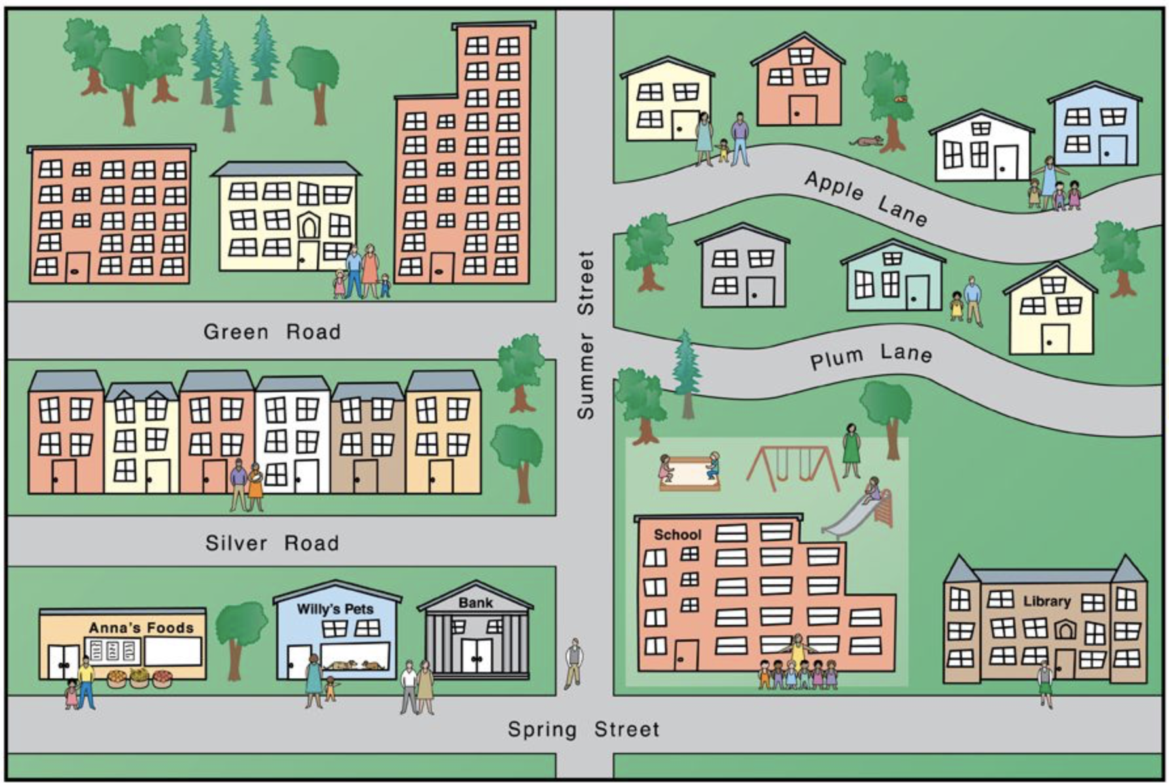
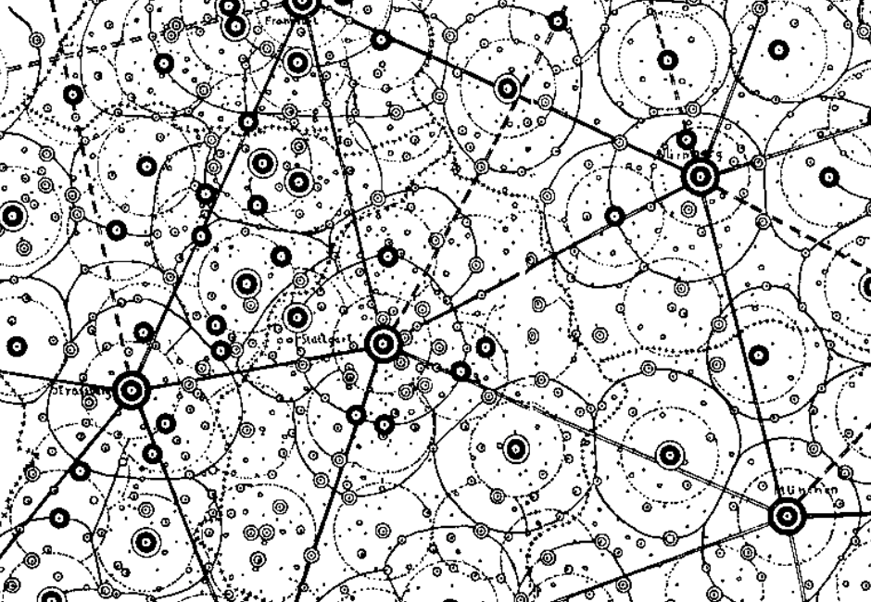
Scale
Integration
Mechanism
$${10}^{9}$$
cognition
life-course
human development
seeds of economic growth
Individual
billions
livability
safety
education
knowledge
$${10}^{6}$$
neighborhood effects
cumulative (dis)advantage
sorting, inequality,
environmental quality
social justice
Neighborhood
millions
selection
segregation
mixing
contagion
$${10}^{3}$$
scaling laws and agglomeration
social + physical networks
economy, information, land uses
City
thousands
migration
trade
knowledge diffusion
laws of geography
gravity law, Zipf’s law
migration, urban hierarchy
$${10}^{0}$$
Urban Systems
one
All Scales Matter for Cities
but different problems at different scales
Ch 1

